Slide 1
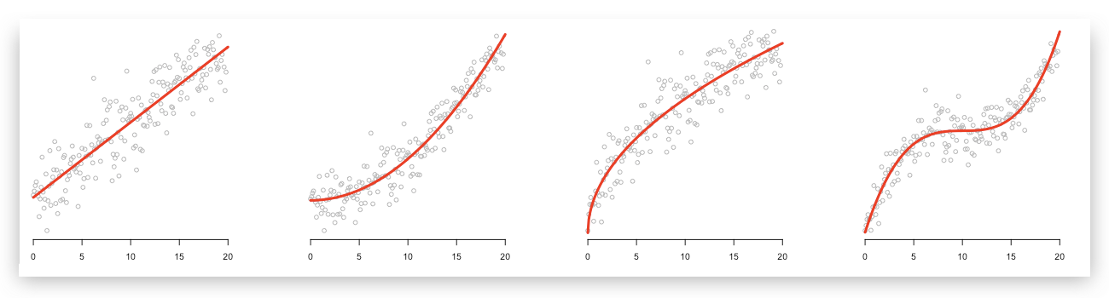
Linear regression and linear models

Slide 2
What is regression?
Find a relationship between an observation variable and an explanatory variable

Slide 3
What is regression?
Find a relationships between an observation variable and several explanatory variables
Often explanatory variables are cheaper/easier to measure but we’re interested in is the observation variable
Allow us to make predictions at new locations (forecasting, decision making)
Allow us to distinguish between models (model structure, hypothesis testing, insight)

Slide 4
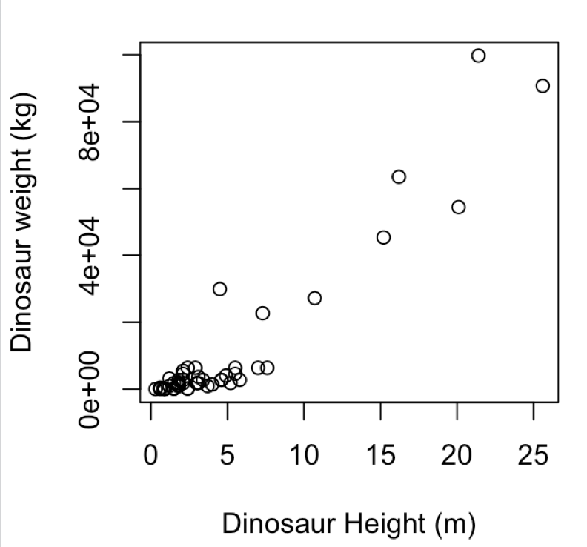
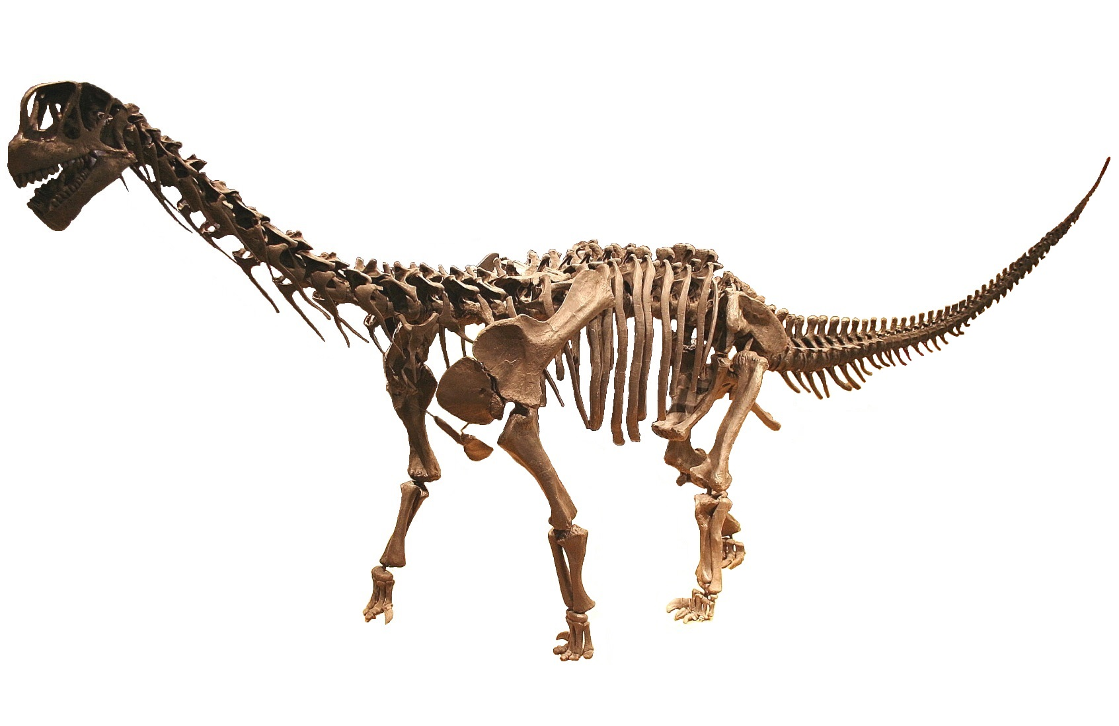
What is linear regression?
Find a relationship between a dinosaur’s height (x) and weight (y)
Both the observation variable and the explanatory variables are continuous
How do we quantify this relationship?
data/Dinosaurs.csv

Slide 5
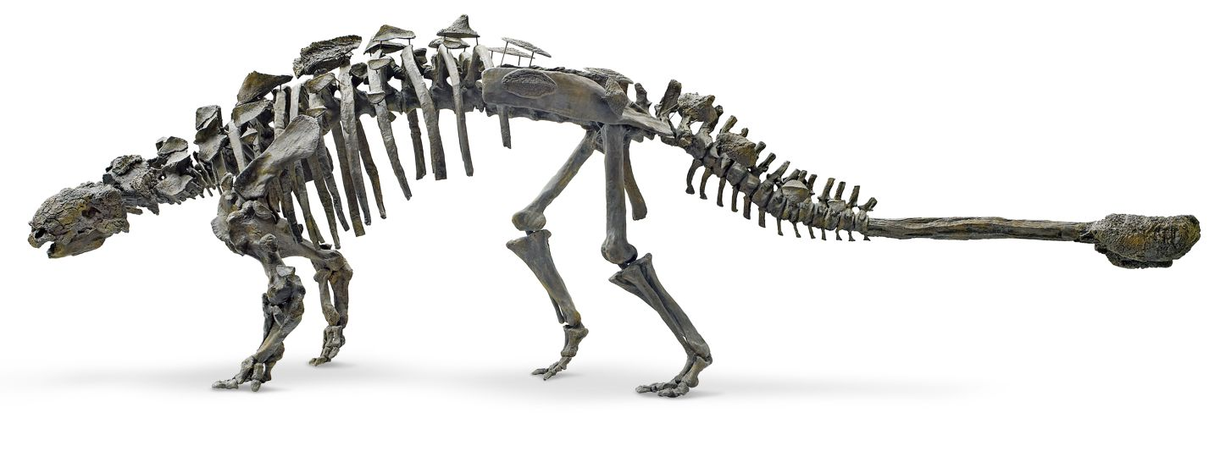
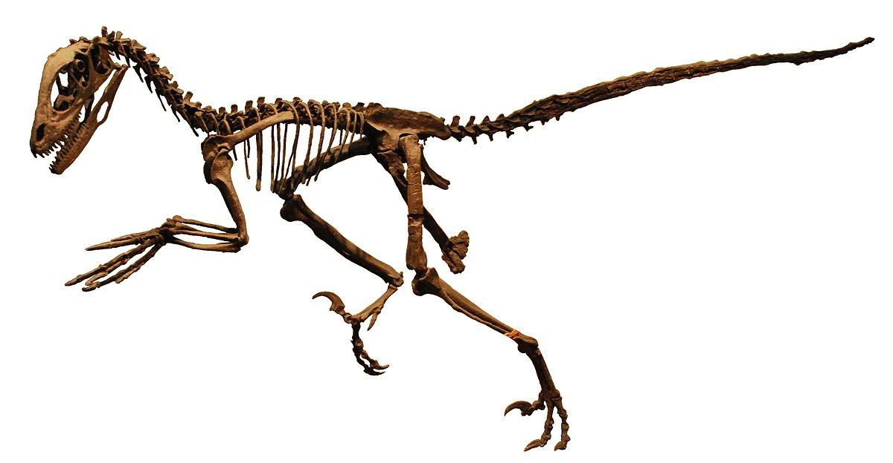
What is linear regression?
How do we quantify this relationship?
When m = 0 we have a flat line
When c = 0 we have a line that passes through (0,0).
intercept
y = m x + c
gradient

Slide 6
What is linear regression?
How do we quantify this relationship?
m
y = m x + c
c = 0, m = (1000-0)/(25-0)
c
y = 40 x + 0

Slide 7
What is linear regression?
How do we quantify this relationship?
y = m x + c
c = 0, m = (1000-0)/(25-0)
y = 40 x + 0
Evaluate the error over the data points

Slide 8
Observation variable
Explanatory variable

Slide 9
Randomly select a training set

Slide 10
SSE
Try different values of (m, c) and evaluate the sum squared error (SSE):
∑ ( (y_{pred} – y_{observed})² )
(here we fix c to the true value and just look at varying m)
m

Slide 15
This model is slightly worse than the previous one

Slide 17
What is linear regression?
Learn parameters (c, m) that minimize an error (here we used SSE)
In this example we iterated over values of m
Is analytically tractable (can solve it to find the value in terms of an equation)
Can predict the values of y* at new location x* (forecasting/decision making)
In this case the best model (minimizing SSE) doesn’t do so well for larger dinosaurs

Slide 18
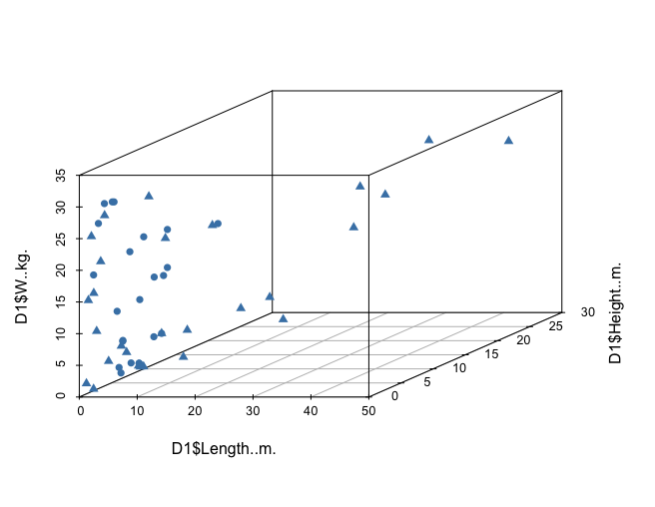
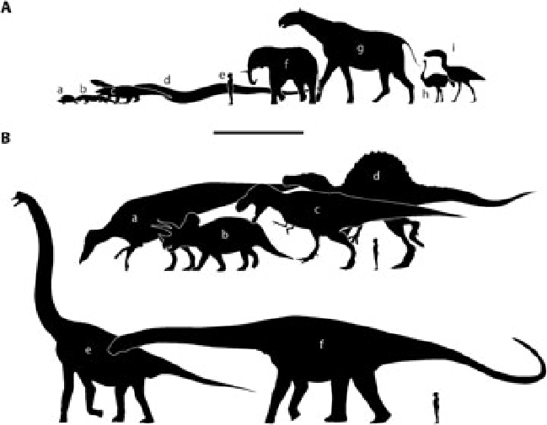
`
Multiple explanatory variables
Dinosaur weight (kg)
Dinosaur height (m)
Dinosaur length (m)
R PSEUDOCODE
z = m₁ x + m₂ y + c
lrfit <- train(z ~ x + y, data, method = "lm")
Our model for z is a linear combination of input variables

Slide 19
`
Multiple explanatory variables

Slide 20
`
Multiple explanatory variables

Slide 21
`
Multiple explanatory variables

Slide 22
`
Multiple explanatory variables
SSE
m₂
m₁
z = m₁ x + m₂ y + c

Slide 23
`
Multiple explanatory variables
SSE
m₂
m₁
z = m₁ x + m₂ y + c

Slide 24
`
Multiple explanatory variables
Dinosaur weight (kg)
Dinosaur height (m)
Dinosaur length (m)
R PSEUDOCODE
z = m₁ x + m₂ y + c
lrfit <- train(z ~ x + y, data, method = "lm")
Our model for z is a linear combination of input variables

Slide 25
Beyond linear regression
m
c
R PSEUDOCODE
y = m x + c
lrfit <- train(y~., x, method = "lm")

Slide 26
Polynomial regression
y = m₁ x² + m₂ x + c
R PSEUDOCODE
y = m₃ x³ m₂ x² + m₁ x + c
lrfit <- train(y~poly(x,degree=3), data, method = "lm")
y = ∑ m_{i} x^{i} + c

Slide 27
Polynomial regression
y = m₁ x² + m₂ x + c
Note: observation data is nonlinear … but we are using a linear model
Observations= (x,x²,x³,…,x^{i}) are fixed input variables
Our model for y is a linear combination of input variables
Parameters = (m₁ , m₂ , … , m_{n} , c) are optimised
y = m₃ x³ m₂ x² + m₁ x + c
y = ∑ m_{i} x^{i} + c

Slide 28
Evaluating performance

Slide 29
Evaluating performance

Slide 30
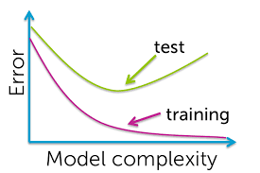
Evaluating performance

Slide 31
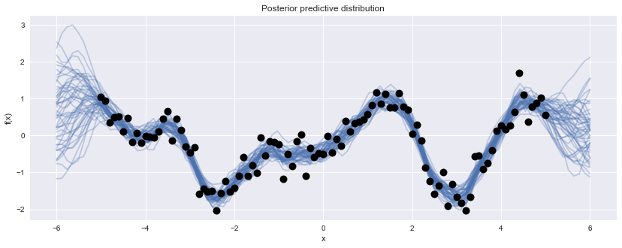
Nonlinear regression
Gaussian processes are a Bayesian nonparametric nonlinear regression approach

Slide 32
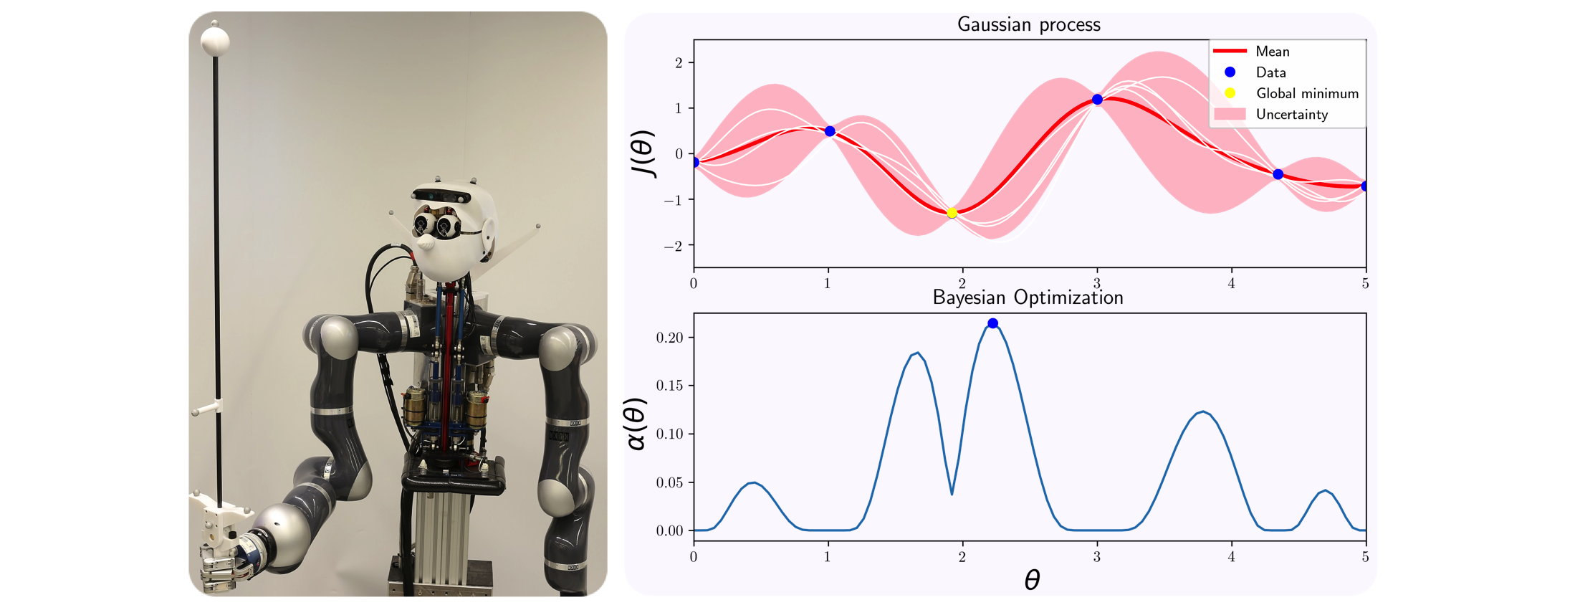
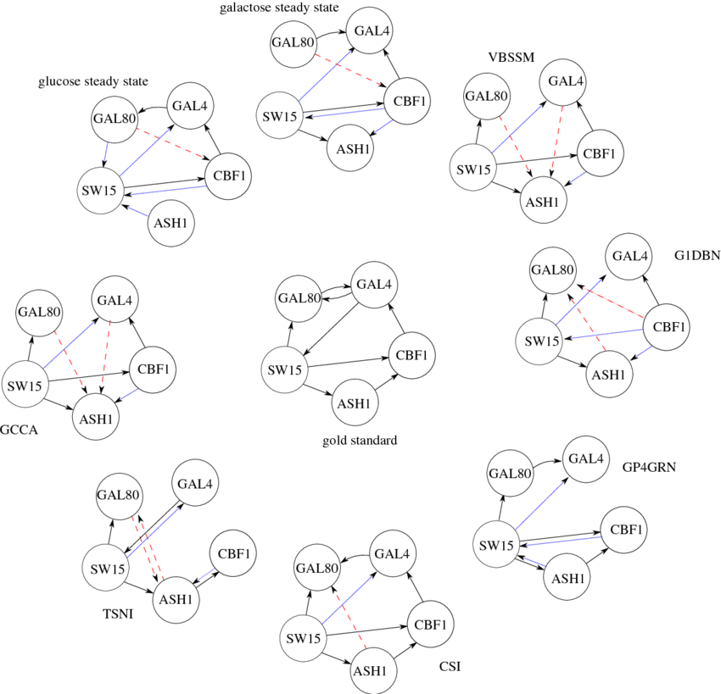
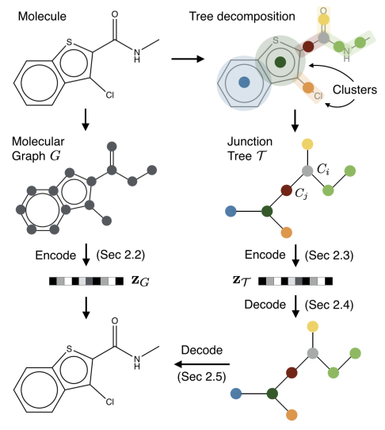
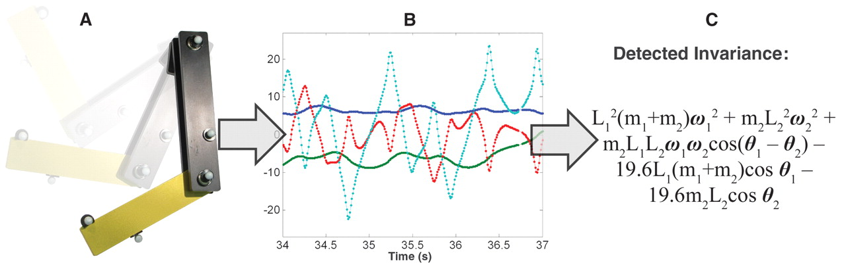
Nonlinear regression
Infer networks
Control dynamical systems
Statistical tests for
time series
Learn fundamental laws of a dataset
Regression over graphs

Slide 33
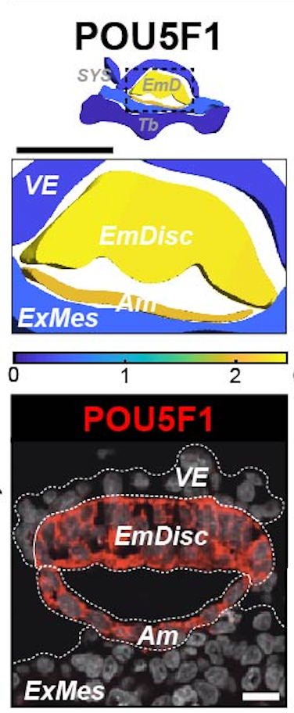
Spatial transcriptomics
=v
Interpolate from discrete samples
Bergmann, Penfold, Slatery et al. (in revision)

Slide 34
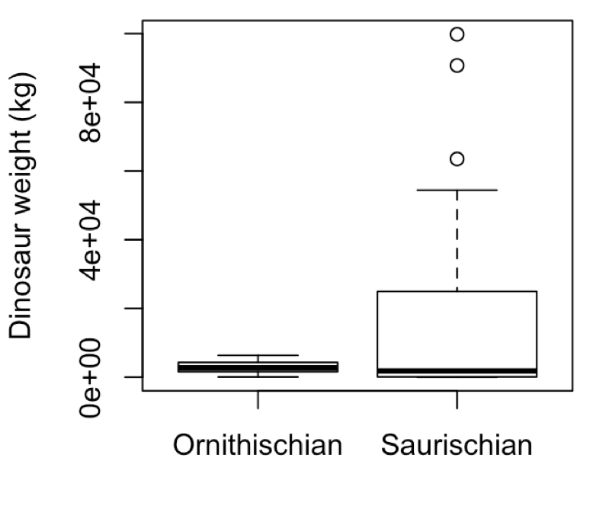
Logistic regression
Logistic regression
Is there a relationship between a dinosaur’s size and its (sub)order? Can we predict the the dinosaurs order given just measurement of its size?

Slide 35
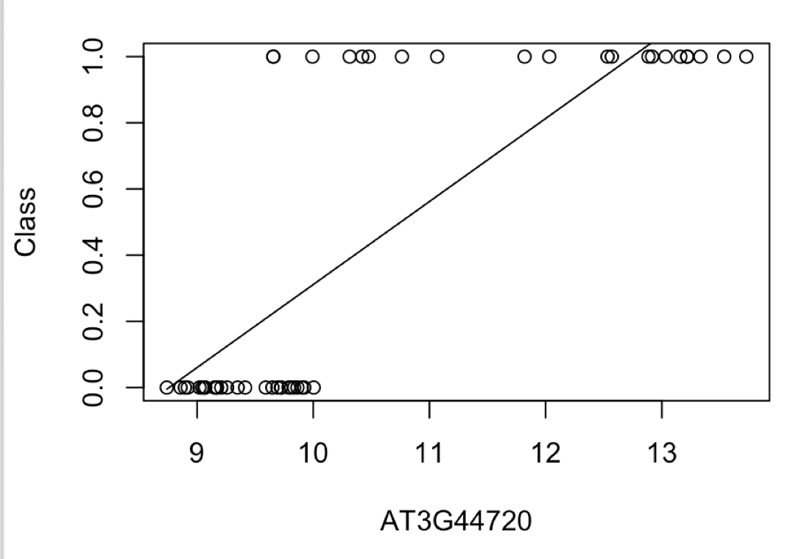
Logistic regression
Explanatory variable x is continuous, but we have binary valued outputs, y
Linear/polynomial regression is no good!
Need a model that correctly accounts for the type of data we have
Suborder
Dinosaur weight/height/length

Slide 36
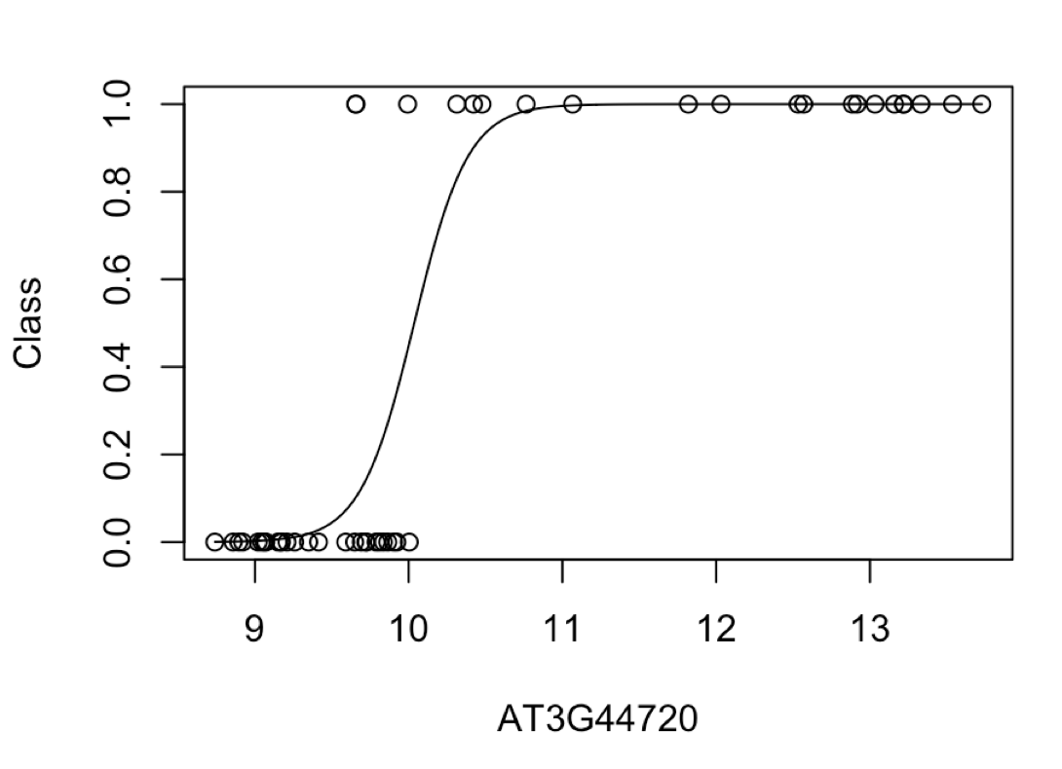
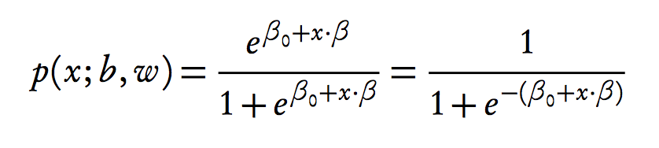
Logistic regression
Model the probability of success using a logistic function

Slide 37
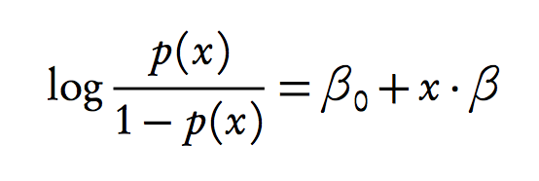
Logistic regression
Model log odds as liner model:
Solve for x
R PSEUDOCODE
lrfit <- train(y ~ ., data, method="glm", family="binomial")

Slide 38
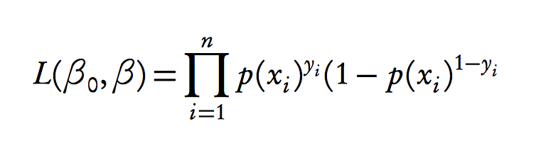
Logistic regression
Model log odds as liner model:
Solve for x
Likelihood
)
R PSEUDOCODE
lrfit <- train(y ~ x, data, method="glm", family="binomial")
Using held out data find parameters that maximises this
likelihood

Slide 39
Logistic regression
Model probability of success
Solve for x
Likelihood
)
Using held out data find parameters that maximises this
likelihood

Slide 40
Logistic regression
Likelihood
)

Slide 41
Logistic regression
Likelihood
)
P(y_{i}=1) = 0.51

Slide 42
Logistic regression
Likelihood
)
P(y_{i}=1) = 0.91

Slide 43
Logistic regression
Likelihood
)
P(y_{i}=1) = 0.91
x = (x₁, x₂, x₃, …, x_{n-1}, x_{n})
y = (0, 0, 1, …, 1, 1)
L = p(y₁=0) x p(y₂=0) x p(y₃=1) x … x p(y_{n}=1) x p(y_{n}=1 )
Give and value of beta0 and beta1 what’s the probability we see the sequence of data y = (y₁,…,y_{n})

Slide 44
Logistic regression
Likelihood
)
Other values for betas?

Slide 45
Logistic regression
R PSEUDOCODE
Multiple input variables

Slide 46
Logistic regression
R PSEUDOCODE
lrfit <- train(y ~ x + z, data, method="glm", family="binomial")
Multiple input variables

Slide 47
Recap: evaluating performance
Evaluating using sum of squared error is a poor choice for performance.

Slide 48
Recap: evaluating performance
Evaluating using sum of squared error is a poor choice for performance.
Count number of correct/incorrect classifications
True positive: Predict y = 1, observation y = 1.
True negative: Predict y = 0, observation y = 0.
False positive: Predict y = 1, observation y = 0.
False negative: Predict y = 0, observation y = 1.
Plot false positive rate (FPR) versus true positive rate (TPR).
Area under the curve (AUC)

Slide 49
Recap: evaluating performance
TPR = TP/(TP+FN)
Sensitivity
FPR = FP/(FP+TN)
Fallout

Slide 50
Recap: evaluating performance
TPR = TP/(TP+FN)
Sensitivity
FPR = FP/(FP+TN)
Fallout

Slide 51
Recap: evaluating performance
TPR = TP/(TP+FN)
Sensitivity
AUC = 1 (perfect classification)
AUC = 0.5 (random classification)
FPR = FP/(FP+TN)
Fallout

Slide 52
Tasks
Start with document: docs/logistic-regression.html
Can open an interactive workbook in R: 09-logistic-regression-gaussian-processes
In Section 3.1 we use linear regression to analyse Arabidopsis thaliana gene expression time series data following inoculation with the necrotrophic fungus Botrytis cinerea

Slide 53
Tasks
Start with document: docs/logistic-regression.html
Can open an interactive workbook in R: 09-logistic-regression-gaussian-processes
In Section 3.1 we use linear regression to analyse Arabidopsis thaliana gene expression time series data following inoculation with the necrotrophic fungus Botrytis cinerea
Fit linear regression model
Predict values at new locations
Fit more complex models
Use sum squared errors on held out data to identify the best model

Slide 54

Tasks
As well as measuring gene expression we also have a measure of infection status (binary data)
Use logistic regression to look for marker genes that are indicative of infection status (Section 1.2)
Main task: As before the main task is to use logistic regression to identify marker genes predictive of infection status. How would you write this up?

